Slide 1

Famous Person In Chhattisgarh Mrs Usha Barle
Madhurima Rawat
Datascience(B.Tech CSE)
Heritage Club CSVTU Bhilai

Slide 2
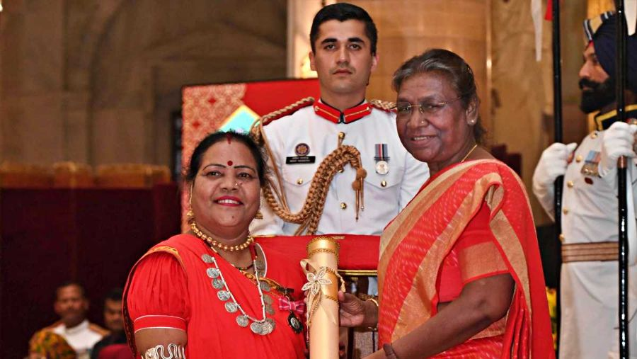
Mrs Usha Barle getting Padma Shree from President DroupadiMurmu

Slide 3
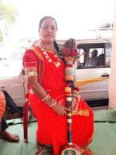
About Usha Barle
From the age of 7, she came into the field of this art. Since then she is singing Pandwani.
She has received training in Pandwani
from renowned Pandwani singer and
Padma Vibhushan Teejanbai.
She has performed Pandwani in various
states of India including cities like London
and New York.

Slide 4
About Pandwani
Actually, the Pandwani singer is a genre of telling the story of Mahabharata in Chhattisgarhi. In which the whole story is told with songs and verses.
Pandavani (Songs and Stories of the Pandavas) is a folk singing style involving narration of tales from the ancient Indian epic Mahabharata.
The singing also involves musical accompaniment. Bhima, the second of the Pandava is the hero of the story in this style.
This form of folk theatre is popular in the central Indian state of Chhattisgarh and in the neighbouring areas of Madhya Pradesh, Orissa and Andhra Pradesh.

Slide 5
Early life
45-year-old Pandwani singer Usha Barle lives in Kohka Housing Board Bhilai.
She has been associated with Pandwani since the age of 7.
In 1975, the first program was introduced in Khursipar.
She said, “I got a big stage, I was 8 years old then. I was picked up in the dock and placed on the stage.”
Apart from Pandwani,she is also well-versed in many folk genres.
She is a Pandwani singer of Kapalik style.
By the grace of God, she has worked continuously in the field of Pandwani singing. This also gave an opportunity to present programs in the country and abroad.

Slide 6
Struggles
Usha Barle says that she also went through a period of financial constraints.
When she remember that time, her eyes become moist.
She used to sell bananas, oranges and other fruits in a sector-1 settlement to run the household.
They were very struggling days. Even after this, she did not give up.
Her husband studied ITI and then got a job at BSP. After this her financial conditions improved.
The Government of India has selected her for the Padma Shri award for her good work in the field of Pandwani.

Slide 7
Career
Usha Barle says that from the age of 7, she started getting interested in Pandwani singing. For this, his guru first became his uncle.
Usha Barle told that her uncle encouraged her and her uncle had said that one day you will brighten the name of your village as well as your state and country, today her dream has been fulfilled.
She says that the state government should open a school for the education of Pandwani, in which the interested children of Pandwani can be educated.
So far, Usha has performed her Pandwani genre in more than 45 countries along with India.

Slide 8
Awards
Pandwanisinger Usha Barle received a Padma Award during the presentation ceremony on Wednesday.
She was conferred with the Padma Shri, the third highest civilian honour.
Along with this, she has been honored with Dau MahasinghChandrakar Award by bhilai steel plant management.
For Pandwani she has been awarded Guru GhasidasSamajik Chetna Puraskar by the Government of Chhattisgarh.
She has also been awarded gold medals six times in GirodhpuriTapobhoomi.

Slide 9
Her other Achievements
Earlier in 2006, he got the first place in New Delhi for presenting a program on Republic Day.
Awarded in Andaman and Nicobar Islands.
The Chhattisgarh government honoured her in 2007.
Bhilai Steel Plant honoured with Dau MahasingChandrakar Samman.
Guru Vijay Kumar awarded the gold medal 6 times in Girodpuridham.
She was also honoured with the Minimata Award.
In the Chhattisgarh Folk Art Festival, Bhuiyan Samman, Chakradhar Samman (Raigarh), Malwa Samman (Kanpur) were honored by Mayawati.
In this way, more than 2000 honors have been honored.

Slide 10
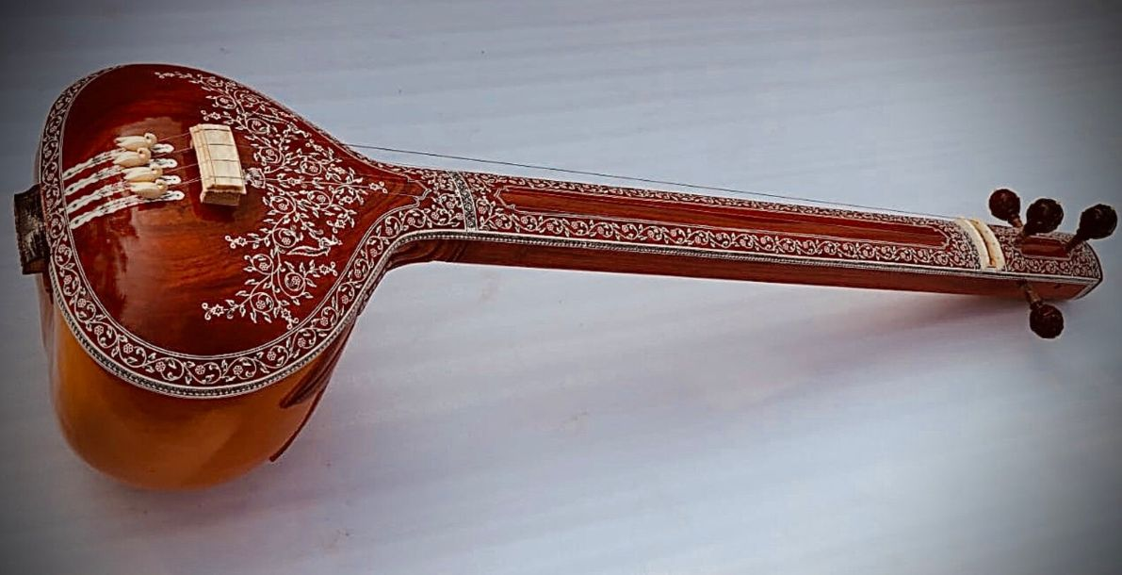
Thank You For Listening To Me

